Slide 1


Slide 2
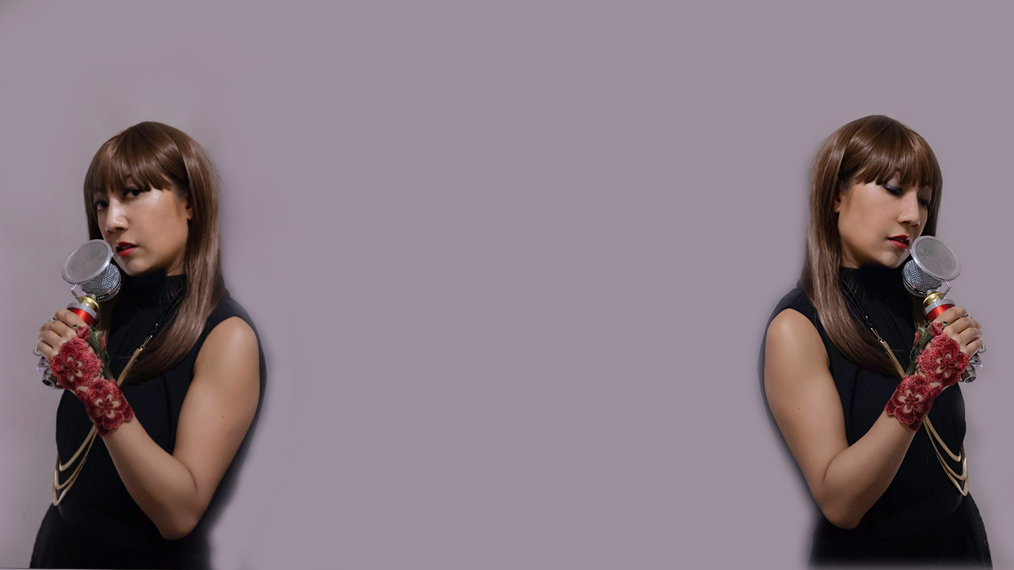

JennyJenny is a local Hong Kong based performer. Primarily a singer songwriter, this original composer produces works of both Cantonese and English music.
​
JennyJenny is an active member of the Hong Kong live music scene having played at many famous venues throughout the region, most notable was playing with the Hong Kong Philharmonic Orchestra.
​
Born and raised in Macau, JennyJenny's love for music began when she first started playing piano at the age of five. JennyJenny's first EP "Air Imagination" released in 2016 is a unique blend of cantopop, electronica and cross cultural sound references.

Slide 3





VIDEOS
JennyJenny is an active Youtuber and updates her content on a weekly basis. View videos below or at www.youtube.com/jennyjennyhk

Slide 4
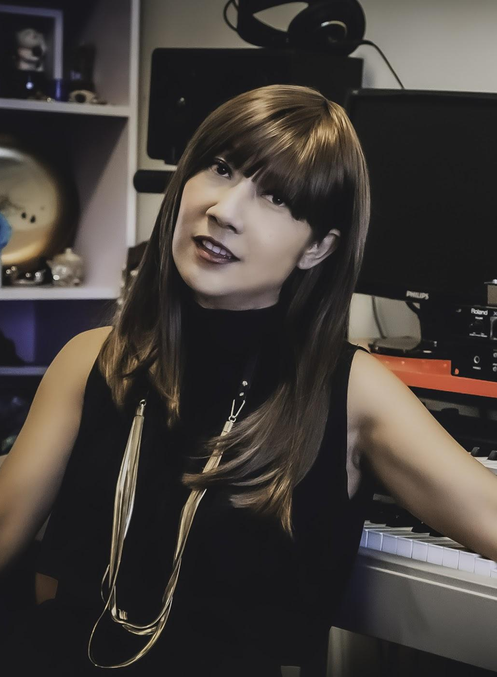
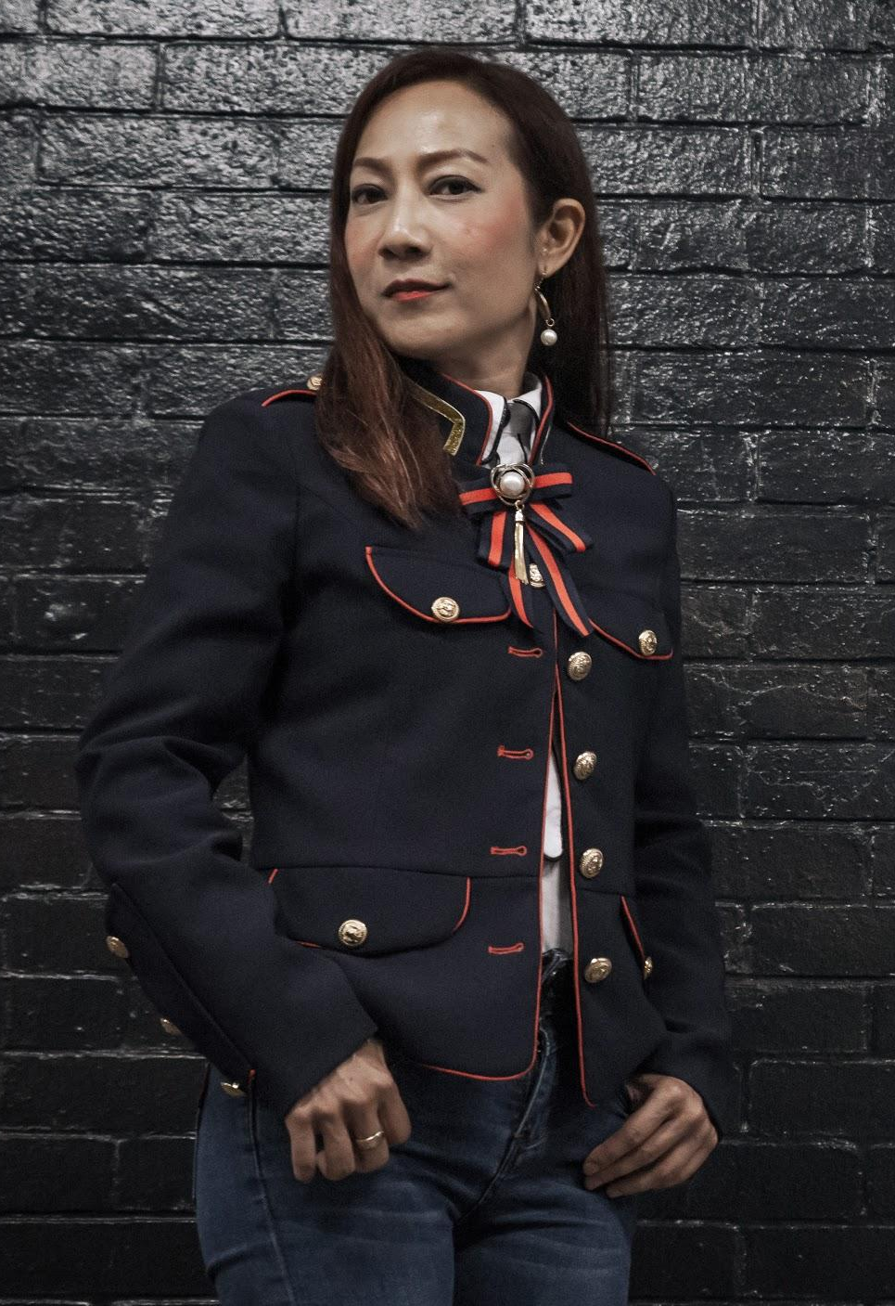
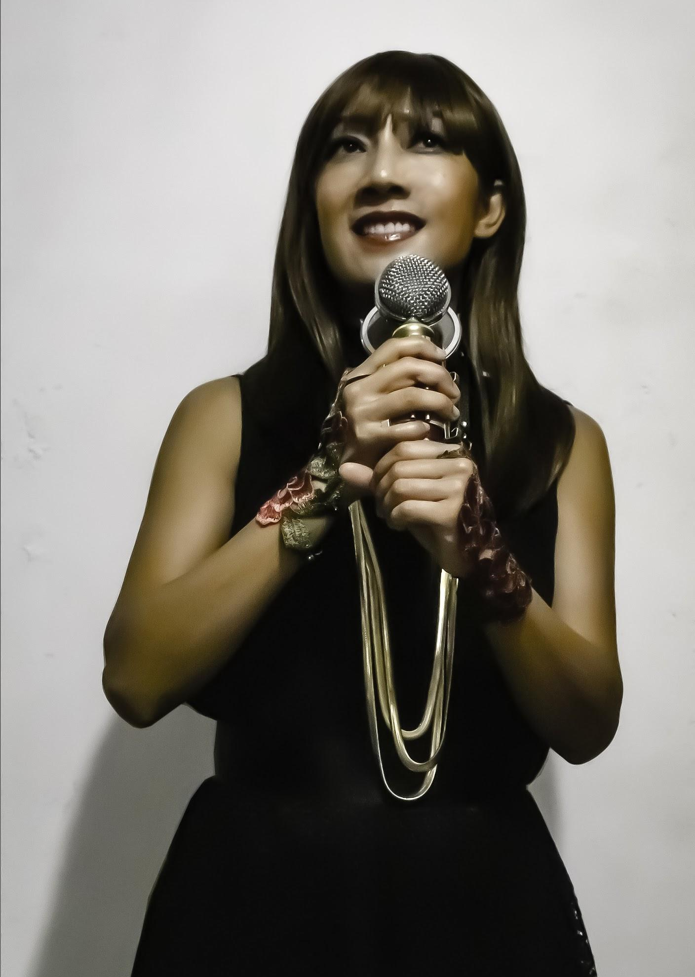
PHOTOS
A selection of photos from JennyJenny that are suitable for design purposes.

Slide 6
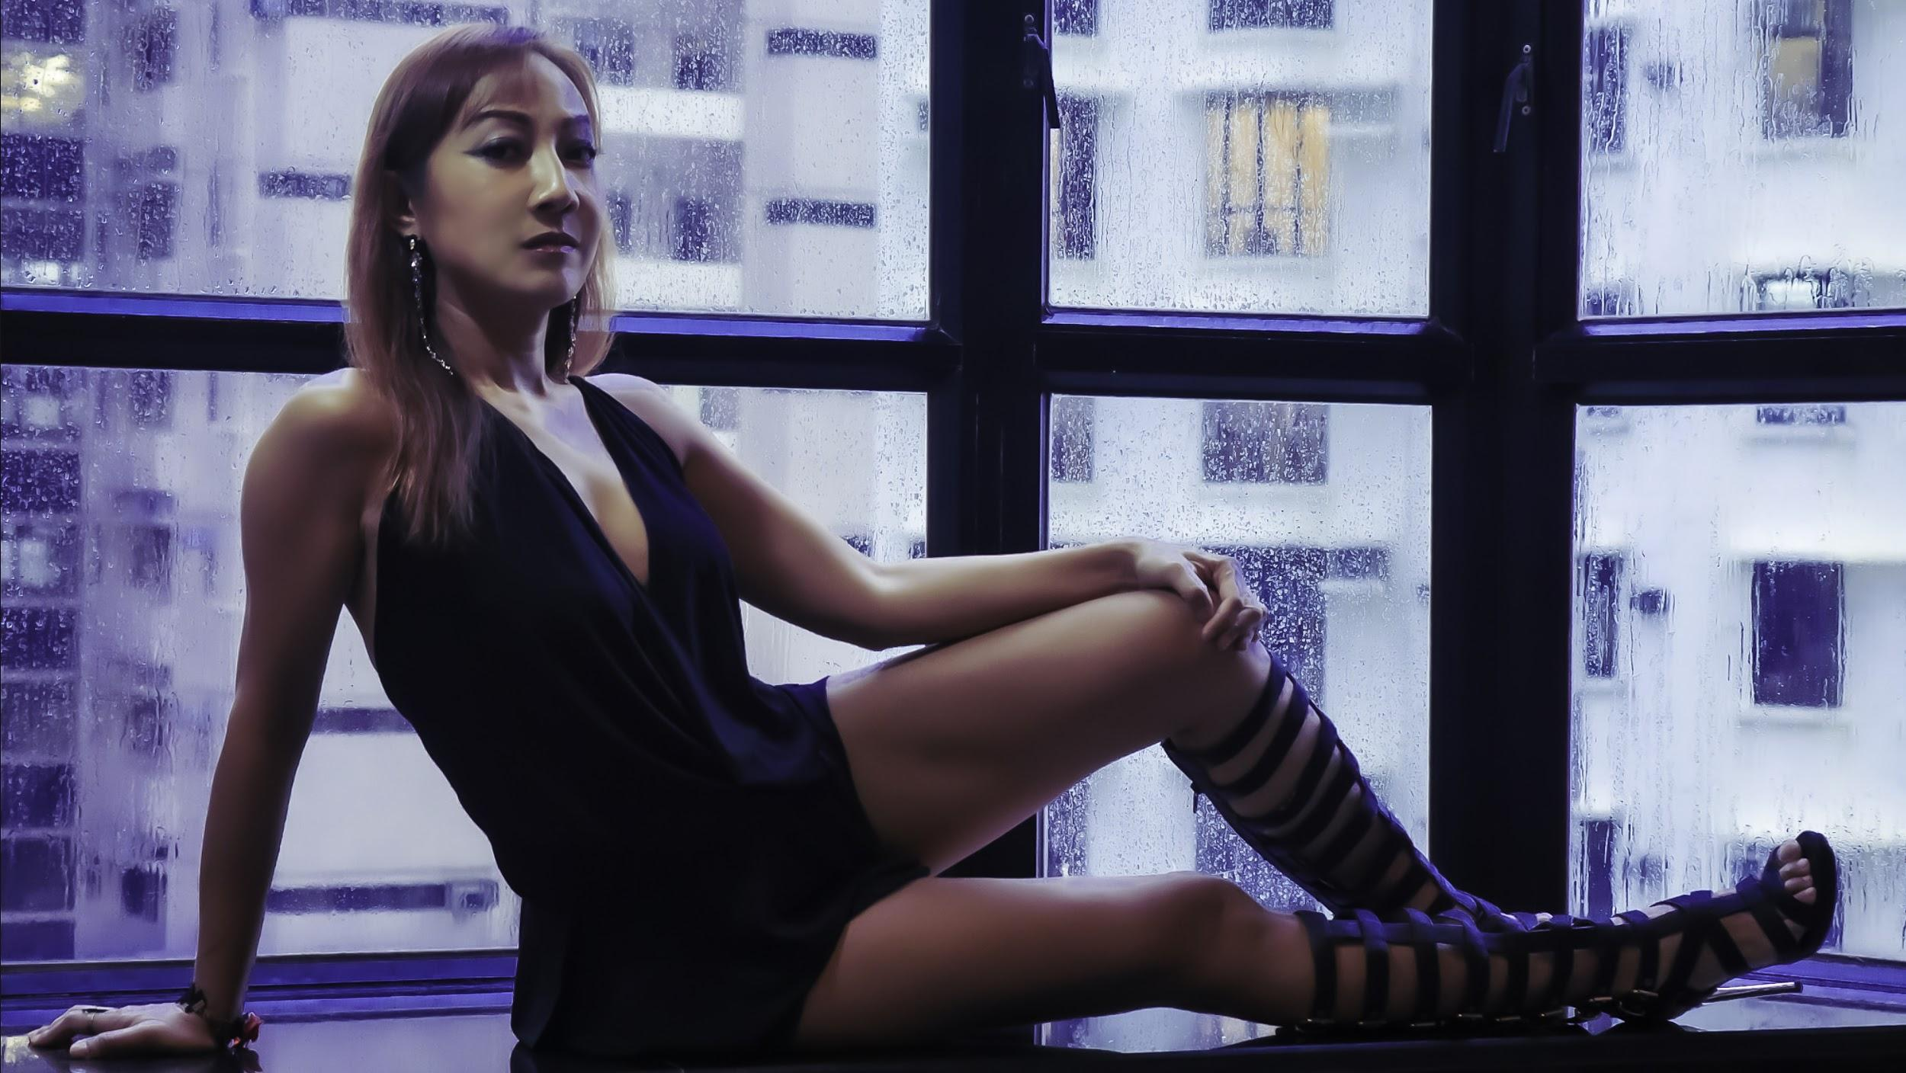
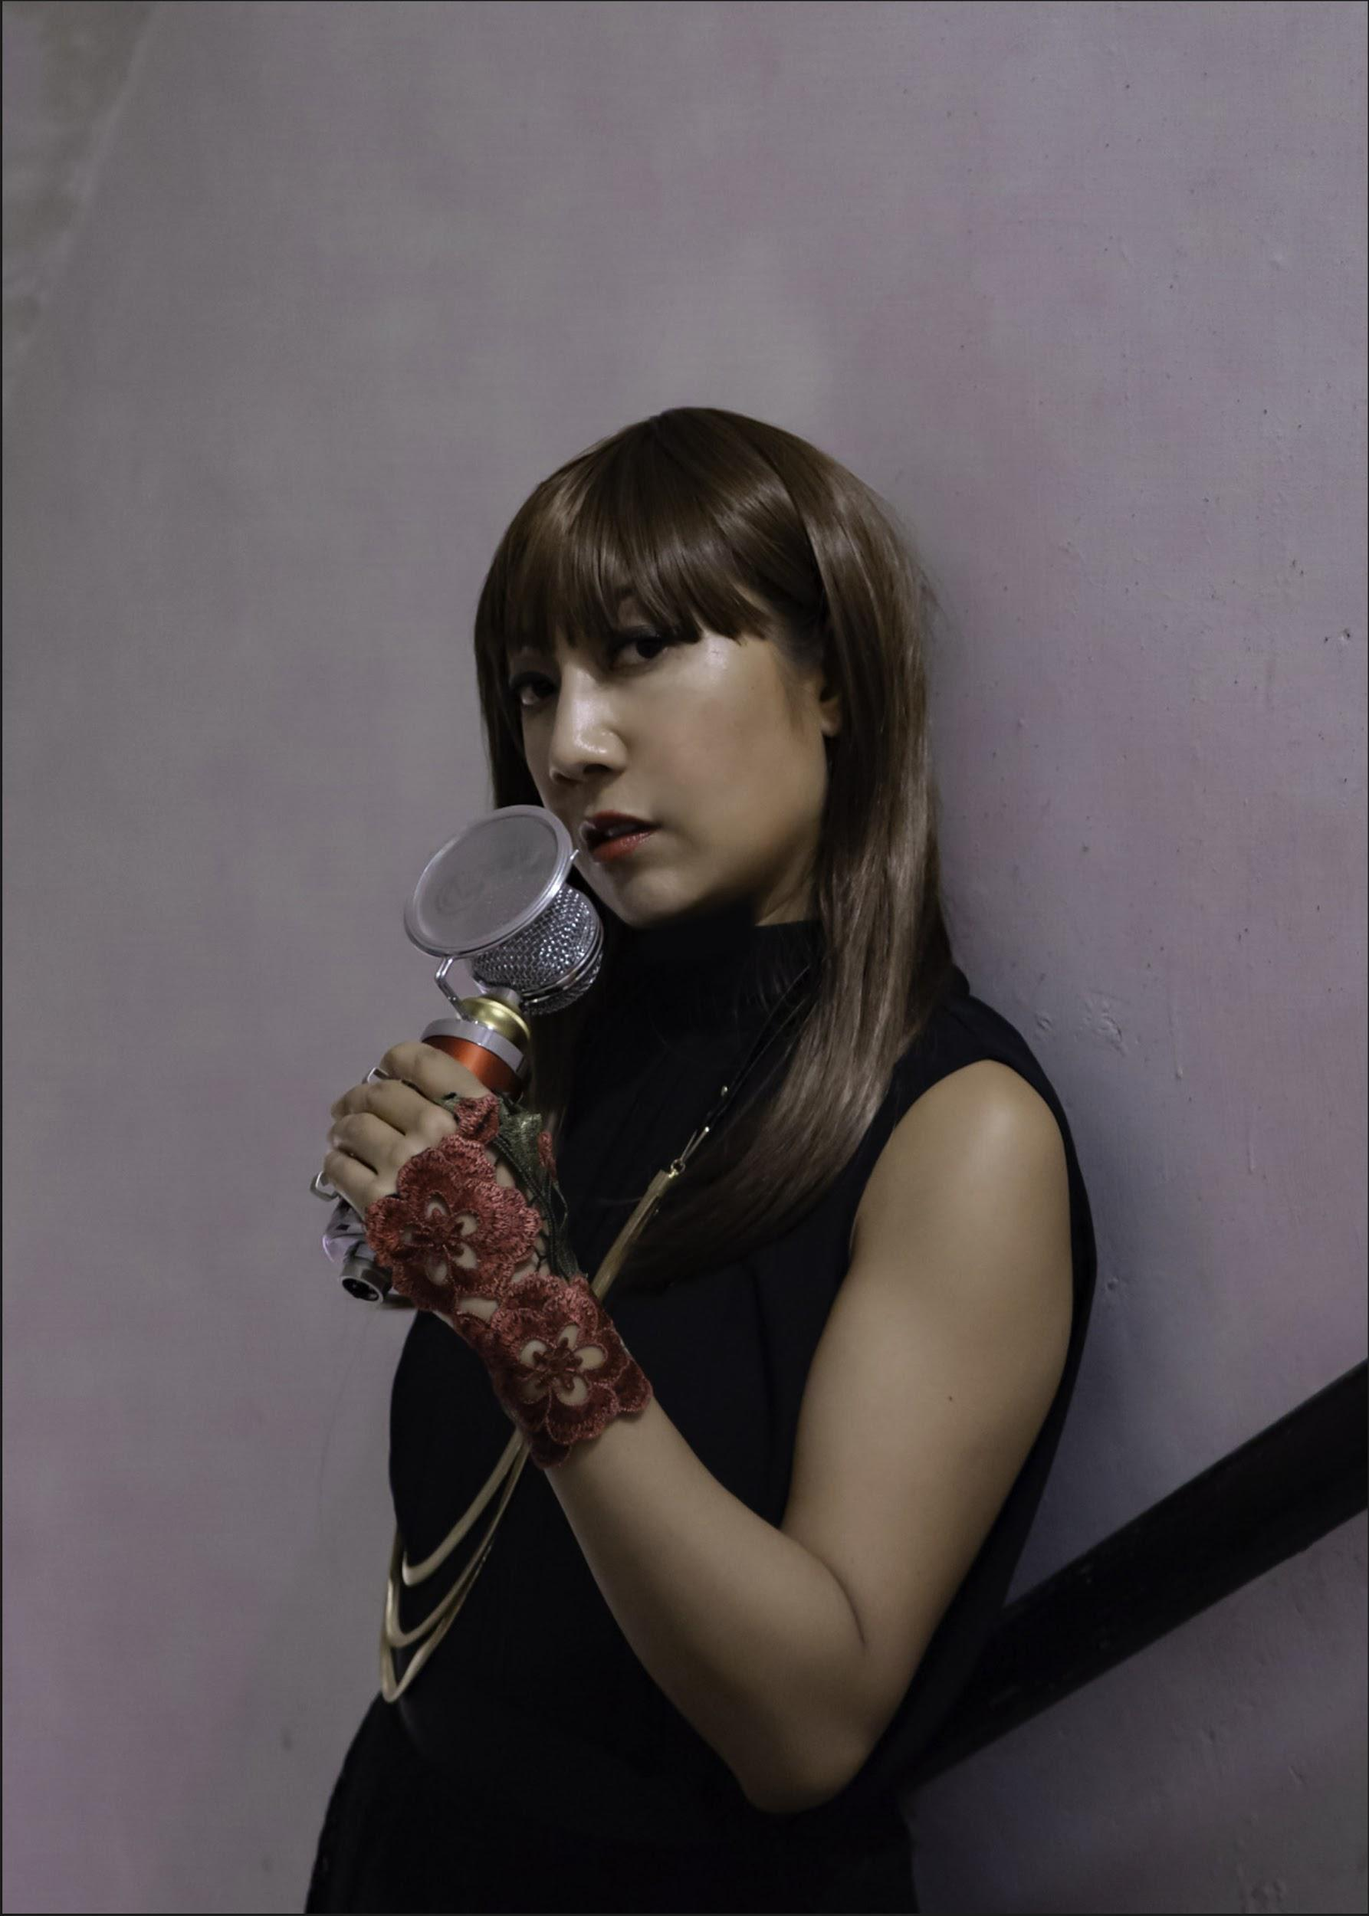
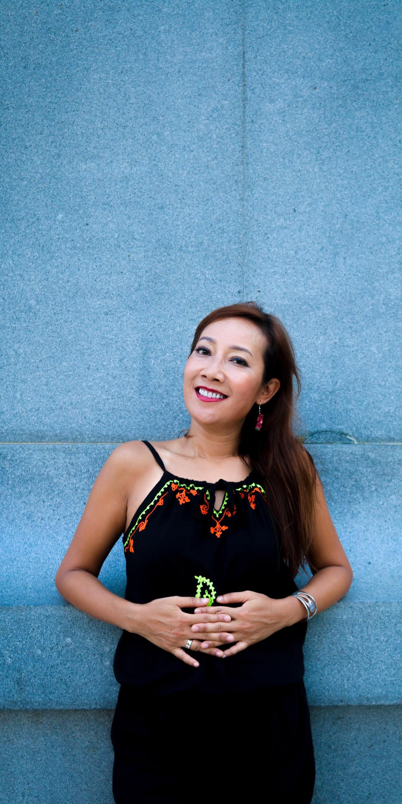
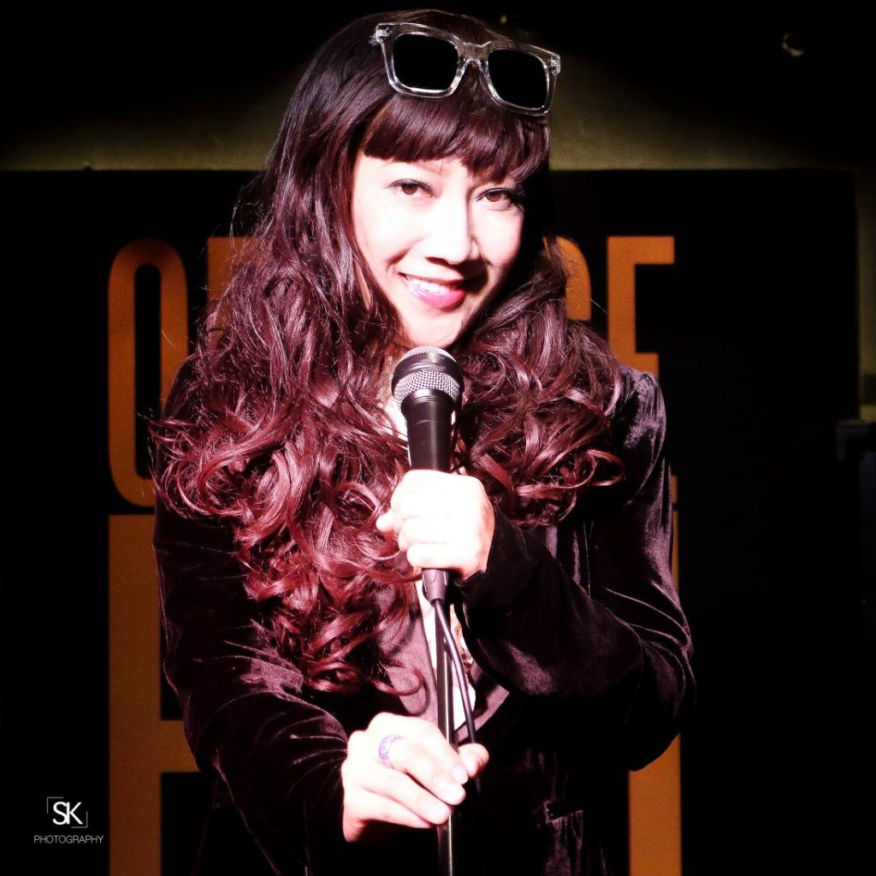
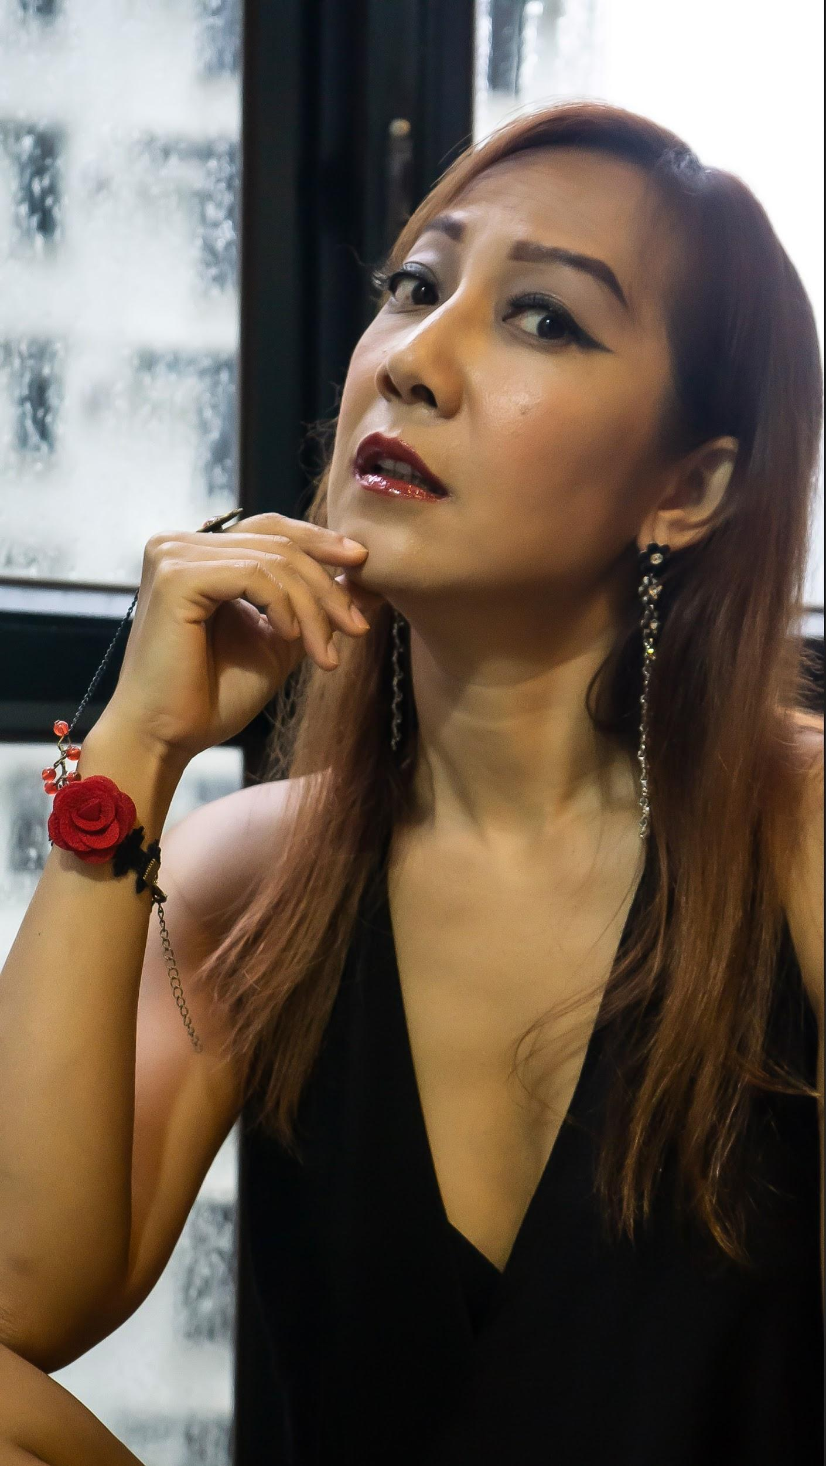
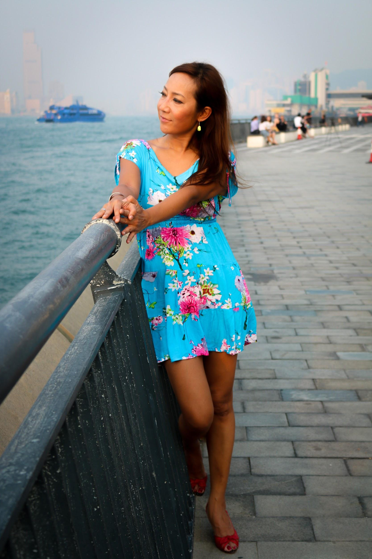

Slide 7
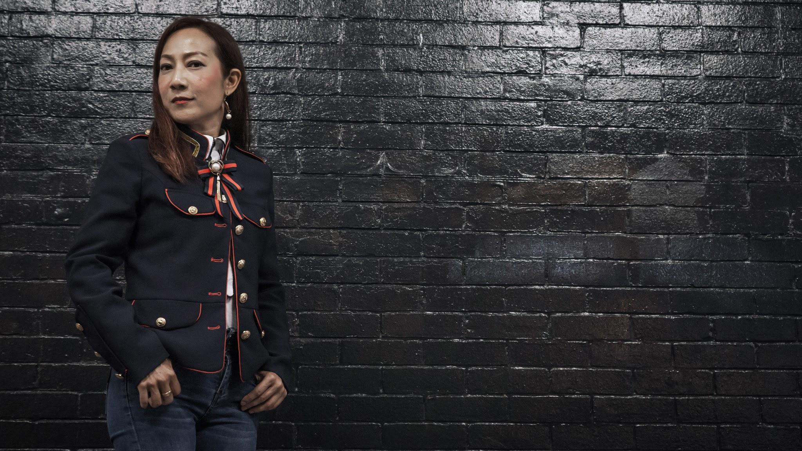
CONTACT
www.jennyjenny.net
mail@jennyjenny.net
Mobile : +852 9365 7700
Telephone: +852 3904 3178
Fax: +852 2550 1179
Suite 1801, 18/F , Chinacham Johnston Plaza,
178-186 Johnston road, Wan Chai, Hong Kong

Slide 8

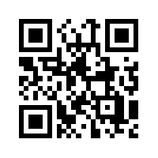
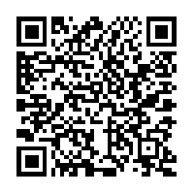
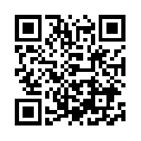
QR CODES
APPLE MUSIC :
AIR IMAGINATION
SPOTIFY: JENNYJENNY
ARTIST PAGE
YOUTUBE: JENNYJENNY
JENNYJENNYHK

